Slide 1
Localization-Sequential Monte Carlo Method
Hui Xue
Shiqi Liu

Slide 2
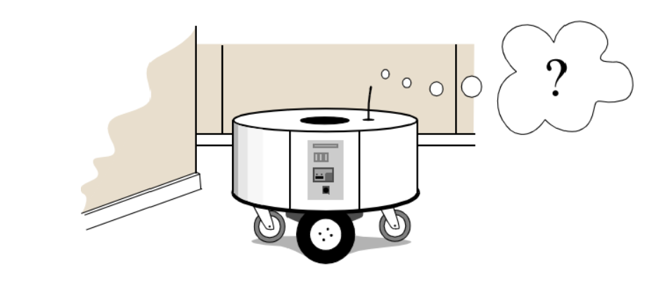
General Purpose
Monte Carlo localization (MCL), also known as particle filter localization, is an algorithm for robots to localize using a particle filter.
The algorithm can estimate the position and orientation of a robot as it moves and sense the environment, given a map of the environment.
The Answer to “Where am I? Where should I go?”
Using particle filter
The particles are generated randomly on the map, containing the possible locations and orientations, i.e. state, of the robots.
When the robot moves, it shifts the particles to predict its new location after the movement.
Calculated the probability of the particle
Keep updating the particles to more accurately reflect where it is
Move forward based on the most consistent location.
Where am I? Where should I go?

Slide 3
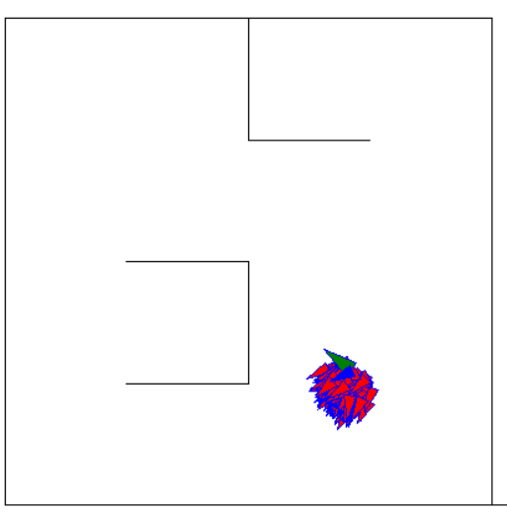
Models
The Map Generator:
The whole environment represented as a randomly generated 2-D map with walls
Changeable width and height of the environment & changeable column number and row number
Red arrows: randomly generated particles Blue arrows(predicted): the weight of all the state of red arrows
The green arrow: the real robot
Walls ↓
↓Walls
Walls ↓
Walls ↓

Slide 4
Hypothesis
The map is given
The robot could start anywhere on the map randomly
The particles are generated randomly on the map
The sensor is noisy

Slide 5


Measurement & Calculate Particle Weight
Get the real robot measurement via gaussian white noise sensor model.
Get measurement from estimate:
Calculate error norm (Euclidean distance)
Calculate the weight via gaussian probability distribution. Weight is proportional to probability.
Normalize all the particles weight to use it for later weighted average.

Slide 6

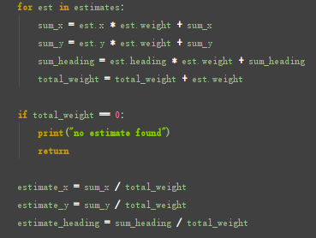
Generate the estimated location
Simply compute the weighted average of all estimates.
The weight is computed in the previous step

Slide 7
Resampling the particles
Choose an old particle in a random fashion.
The probability of an old particle to be selected equals to the normalized weight.
Choose n times
Each time, make a random selection of an old particle
Generate a new particle around the selected particle, following gaussian distribution.
When the for loop finishes, max_num_of_estimates(256) of new particles will be generated
Replace old particles with new particles.

Slide 8
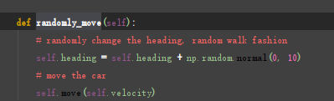
Move the actual robot
Randomize the heading around the current heading
Random walk
Move the car based on current velocity

Slide 9
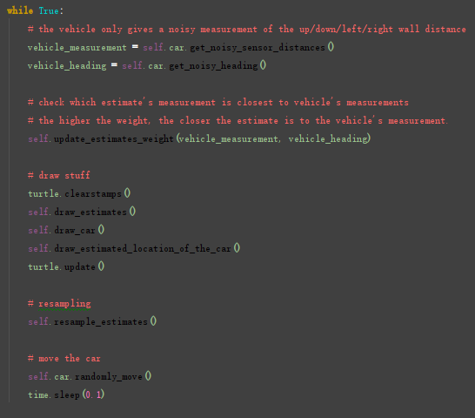
The full loop

Slide 10
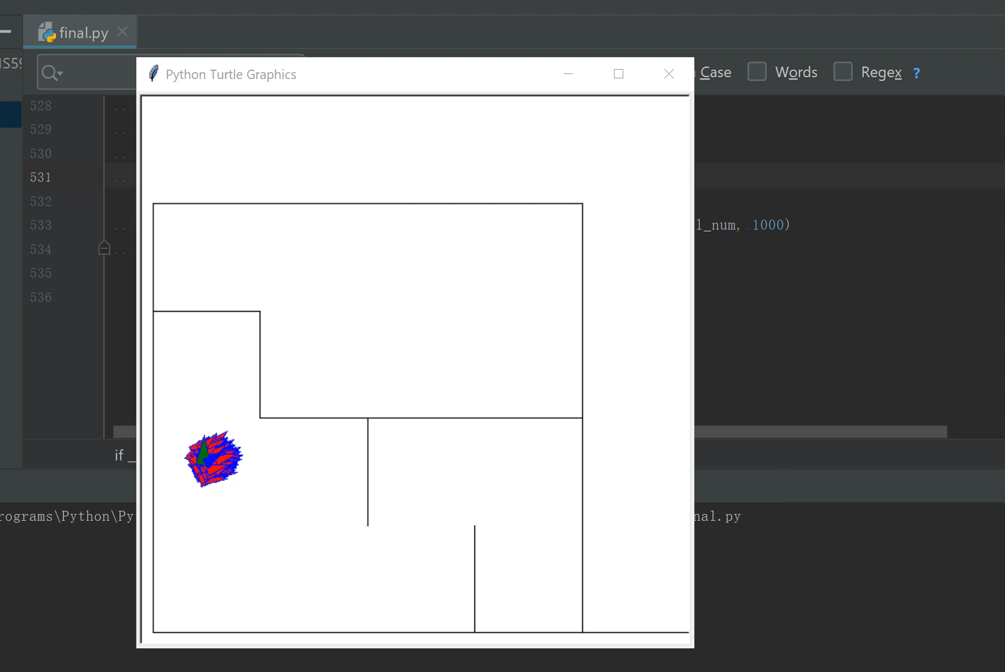
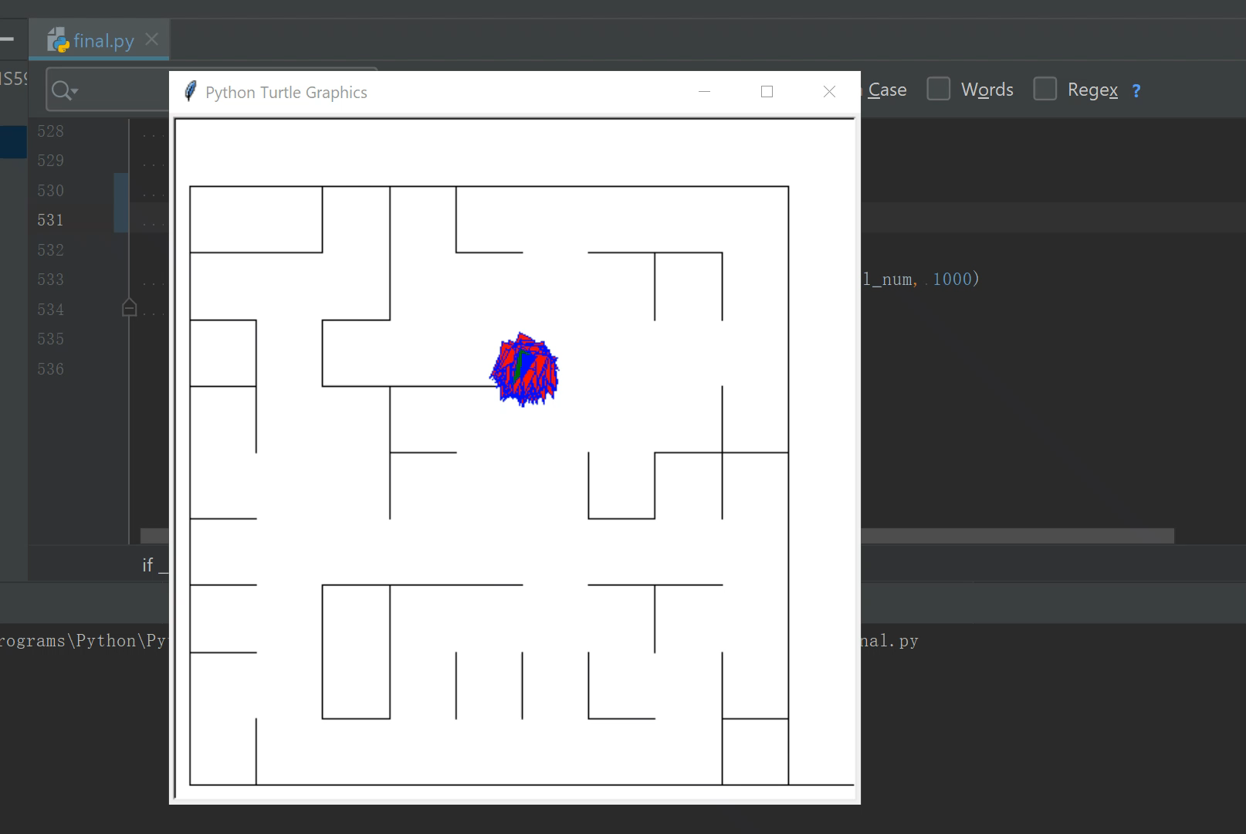
Demo
With column number 5 and row number 5: With column number 10 and row number 10:

Slide 11
Improvement
Make more samples
Use Applied Monte Carlo Localization
Thank You!

Slide 12
References:
https://en.wikipedia.org/wiki/Monte_Carlo_localization
https://www.cnblogs.com/21207-iHome/p/5237701.html

